Slide 1



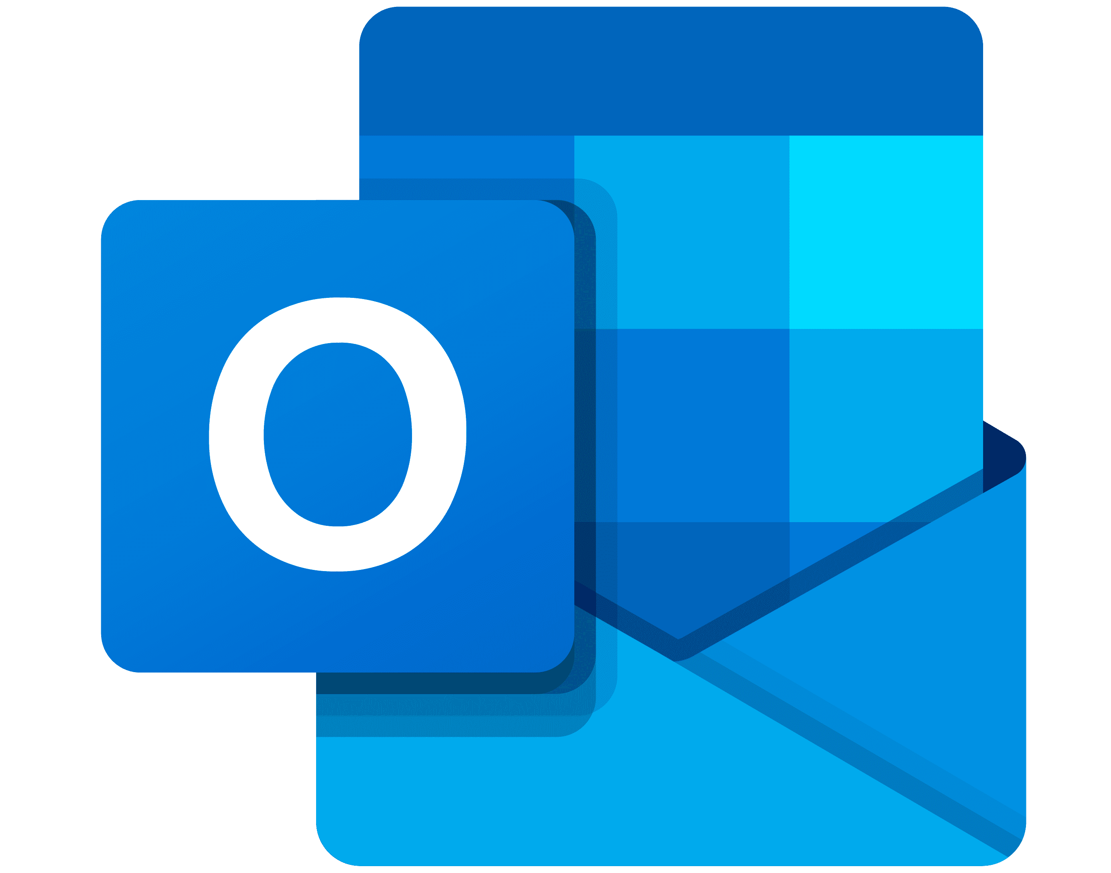
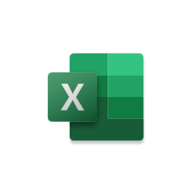
Already using Microsoft Outlook, Teams, and Excel?
Work smarter with a 10% discount on Business Central.
Seamlessly connect Business Central + Microsoft 365 and harness the power of Microsoft Copilot
REACH OUT TO DYNAMICS365@Ingrammicro.com for more info!
Collaborate in the apps where teams work best. Connect Business Central to Outlook, Excel, and Teams— work seamlessly together with timely data.
Stay in the flow of work. Get the data employees need in the tools they prefer— without switching applications.
Microsoft Copilot
Business Central
Connect the dots with Microsoft Copilot. Work between applications with greater continuity, guided by AI. Get help drafting emails, summarizing information, and more —no matter where you work.
Teams
Outlook
Excel
Microsoft 365
*For a limited time, businesses using Microsoft 365 can receive a 10% discount on Business Central Essentials and Premium licenses. Offer available August 1, 2024 - June 30, 2025, to new Business Central customers globally. Terms and conditions apply.
Notes:
Collaborate in the tools where teams work with seamlessly connected data between Business Central and Microsoft 365. Work seamlessly together and remain in the flow of work.

